Slide 1
Data Quality Issue Detection Using Statistics
Michael Han – Murali’s Team

Slide 2
Agenda
About Me
Summer Intern Project
What’s Next?

Slide 3








About Me
Education/Job Experience
Interesting Facts

Slide 4
Summer Project

Slide 5


Data Quality Summer Project
Create Two Data Quality Programs
Outlier Detection
Data Ingestion Validation
Detect bad data within each column in a table
Generalized script for any table within any data mart
Calculate how many records a table should have
Flag all tables that deviate from normal
OUTLIERS
Notes:
-- Outlier detection
-- Data ingestion validation using trend analysis
Historical load metadata and relavent statistics collection
List out three topics without going into details

Slide 6

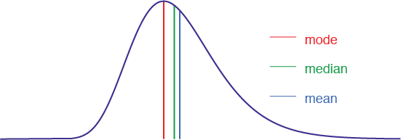
Outlier Detection
Outlier – anything that is not “normal”
  So, what’s normal?
Calculating “Normal”
  Numeric
  Mean and Standard Deviation
  Median and Median Absolute Deviation (MAD)
  String
  Frequencies for categorical variables

Slide 7
Outlier Detection
Notes:
Remove slide

Slide 8
Outlier Problem and What We Can Do
Problem
Toyota has potential to use bad data for day-to-day operations
Checks are in place for some tables but not all tables
Solution
Developed Outlier Detection Program
  Uses Statistics to detect obvious outliers
  3 Median Absolute Deviation (MAD) or 2 Standard Deviations
Build Trust in Data provided

Slide 9


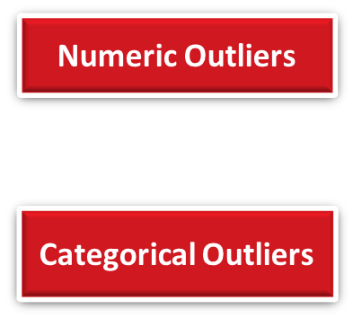

Outlier Detection Flow Chart
Monthly
Configuration File
  Database
    Table
    Column
    Group By Column*
Column Statistics
µ σ Frequency
Historical Date Range
If non-normally distributed – Median/MAD
Daily
Numeric
Numeric Column
Statistics
Config
Current Day - 1
Table
Column
Categorical
Category
Frequency

Slide 10


Numeric Outliers
Categorical Outliers
Easily identifiable
Numeric Averages grouped by config specifications
Outputs entire row with numeric column outliers separated
More challenging
Average/standard deviation of frequency across prior month
Only outputs categories that deviate from normal
Checks if column follows Normal Distribution
Uses Median and MAD for non-Normal distribution
Categorical = less than 20 unique values
Flags new categories for current day

Slide 11
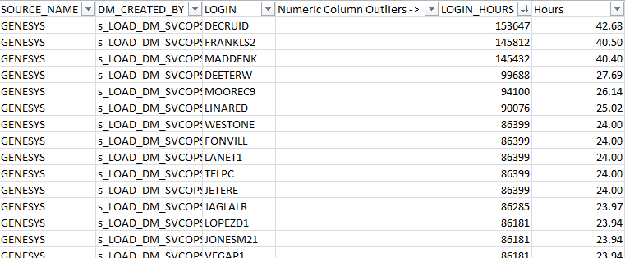
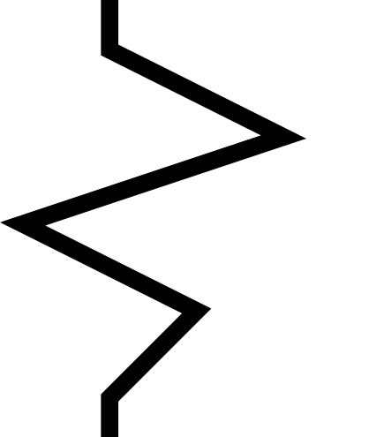
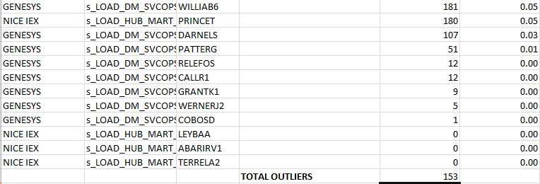
Anomaly Detection Results
Use Case 1: DM_CUSTOMER_SVCOPS_ACTIVITY_ADHERENCE_FACT - 07/20/2018:
Agents log in to log hours worked for a given day.
Hours worked is a factor in determining agent bonus points
Identified 153 ‘LOGIN_HOURS’ outliers out of 2307
  i.e. 42 hours worked in a 24 hour day
Outliers found on both high end and low end – due to script generalization
Notes:
Replace circle with square
Take an average bonus
This data has a 60 days window
No process today
Does this get typically flag and the potential
Bonus points == what could happen
Worst case scenario – what is potentially possible

Slide 12
Data Ingestion Validation
Notes:
Rename slide based on notes from slide 6

Slide 13
Data Ingestion Problem
Problem
Some tables are not loaded with records
Log table does not fully capture table activity
Solution
Developed program that will:
  Detect which tables have zero records
  Classify tables by update frequency
  Calculate average number of records loaded
Ensures data is available for TFS use

Slide 14





Data Ingestion Validation Flow Chart
One Time
Monthly
Determine Table Update Frequency and Initial Statistics
Bin Tables by Frequency
Calculate Average Records Table Receives
Store Reference Statistics
Daily
Pull Total Count of Records for Current Date - 1
Flag No Records
Flag More Than Expected
Flag Less Than Expected
Notes:
Include a problem statement slide that this program will help solve for both flow charts
Benefits slide from the problem

Slide 15

Table Flagging
Flag tables for zero received records for daily, week, month, and quarter
Flag tables with new records
Historical Analysis
  Pinpoint which period (day, month, etc) has zero, less or more than expected
ERROR
ERROR

Slide 16
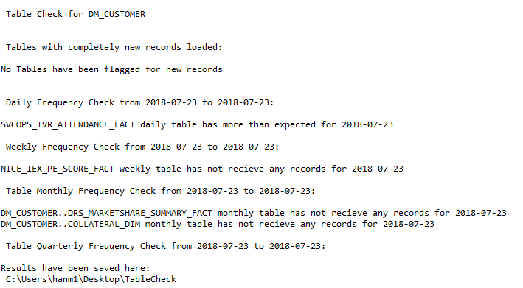

Table Scan Results
07/24/2018

Slide 17
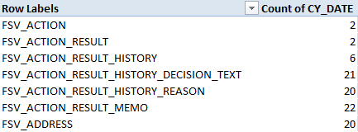
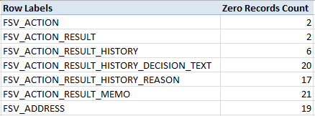
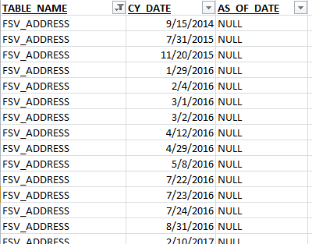
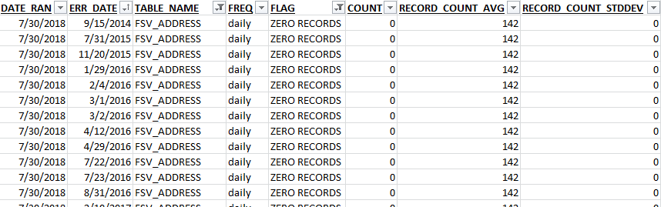
Table Scan Results – Historical
FSV tables from 01/01/2014
  Small difference are due to the addition of weekends
Report Ran by TFS
Data Ingestion Validation Program

Slide 18

Project Challenges
Generalized program with limited accuracy
  Pure statistics approach
  Efficiency improvements
Personal Challenges
Underestimated the sheer size of data
Notes:
Put at the end of presentation

Slide 19

What’s Next?
Outlier Detection
Unsupervised machine learning algorithms
Outliers for non-categorical
Apply to HUB and STAGE
Put into production
Table Scanning
Seasonality of record loading
Accuracy increase over time
Put into production
Notes:
Productinalizing both programs

Slide 20
Questions?
Thank You!!

